Slide 1
Anti Anti-Forensics: Correlation
Tony Rodrigues, CISSP, CFCP
inv.forense (at) gmail (dot) com

Slide 2

Who am I?
Tony Rodrigues, CISSP, CFCP, Security+
IT Manager and Information Security Consultant
Computer Forensics Practitioner
Blog: http://forcomp.blogspot.com

Slide 3
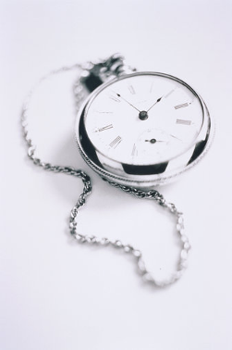
Agenda
Introduction
Aligning Perspectives
Acquisition and Analysis Strategies
Anti Forensics: Definitions
Techniques, Counter-Techniques and Counter-Counter Techniques
References

Slide 4


CF Practitioners and Anti Forensics Hackers
X
They make us work harder
They support criminals
They teach subversive techniques

Slide 5

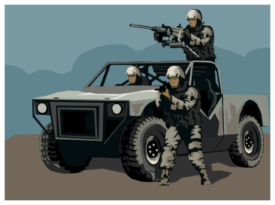
Anti Forensics Hackers and CF Practitioners
X
Just Script kiddies and Lammers
Anti-Hacker guys
They are our enemies

Slide 6

First thing: Aligning Perspectives
Both are important for the process
Anti Forensics is the power that leads our techniques to evolve
Improvement is the natural result
  Process
  Techniques
  Tools

Slide 7


Acquisition and Analysis Strategies
X
Live Acquisition
Live Analysis
Dead Acquisition
Dead Analysis

Slide 8

Anti Forensics, What is it ?
Exploitation of vulnerabilities in computer forensics tools or techniques, in order to decrease quantity and quality of artifacts
Techniques
  Destroy artifacts
  Hide artifacts
  Subvert artifacts
In a nutshell, information artifacts must be ruined, so investigation will be ruined too

Slide 9
Correlation
Artifact
Artifact
Action
Artifact
Artifact

Slide 10
Correlation
Action
Action
Operation
Action
Action

Slide 11
Correlation
Operation
Operation
Incident/Case
Operation
Operation

Slide 12

The Suggestion: Correlation (II)
Correlate artifacts:
  To recover destroyed, hidden or subverted data;
  In order to get conclusions in spite of destroyed, hidden or subverted data;
  To alert that data destruction, data hiding or data subversion has occurred;
Anti Forensics has its own footprints
Locard Principle: There is always exchange when there is contact

Slide 13


Techniques, Counter-Techniques and “Counter-Counter-Techniques”

Slide 14

Timeline
MAC Times
  Creation
  Last Accessed
  Last Modified
Hard Disk file’s timeline creation
Technique
Subvert MAC timestamps
  Inserting false timestamps
  Destroying timestamps
Ex: Timestomp
Counter Technique

Slide 15

Timestomp
Change Last Modified Timestamp:
timestomp arquivo.exe –m “Monday 07/28/2008 01:40 AM”
“Reset” MAC timestamps
timestomp arquivo.exe –b
Date Created 01/01/1601 02:00:00:000 10/18/2009 22:59:37:203
Last Written 01/01/1601 02:00:00:000 10/18/2009 22:59:37:203
Last Accessed 01/01/1601 02:00:00:000 10/18/2009 22:59:37:203
Entry Modified 01/01/1601 02:00:00:000 10/18/2009 22:59:37:203

Slide 16
Timestomp: Counter-Counter-Technique
Same to Live and Dead Analysis
Detection:
  Compare timestamps of SIA attributes with FN attributes (NTFS)
    FN attributes timestamps must be older than SIA timestamps
  Zero milliseconds in timestamps is suspect
  Check creation timestamps earlier than file system format date
    We can get FS format date in $MFT timestamps
  Check Shadow Copy (WinVista) and Restore Point

Slide 17
Timestomp: Counter-Counter-Technique (II)
Create a complete timeline
  Include system events, logs, registry, prefetch, recent shortcuts
  It can help to find out the true file or event timestamp
Tools
  TSK based scripts
  Timehound (attention: it changes A-times !)
  Append data to TSK bodyfile + mactime

Slide 18

File Type Filtering
File Filtering/Sorting:
  By extension, Header and/or Footer (magic numbers)
Keeps the investigation focused on what really matters
Technique
Change extensions and subvert headers:
  To deceive the file type
  To forge a new file type
Ex: Transmogrify
Counter-Technique

Slide 19
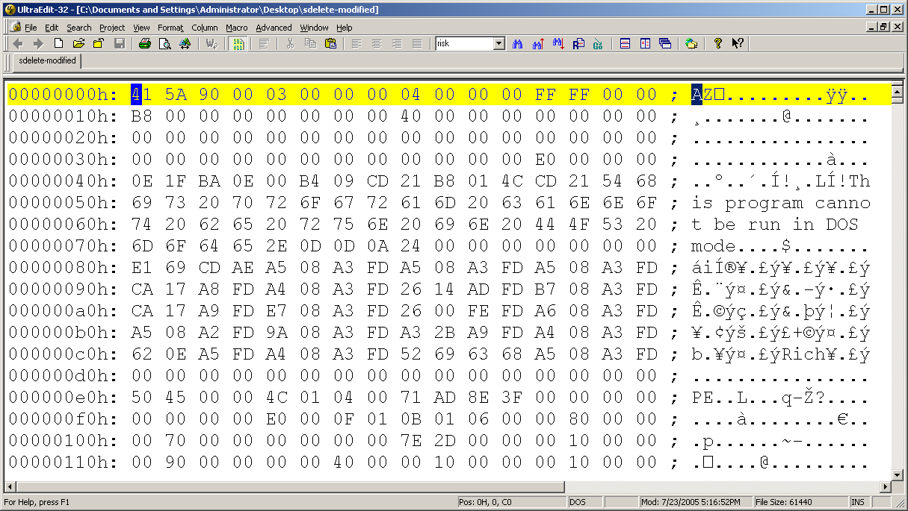
File Type Filtering (II)

Slide 20
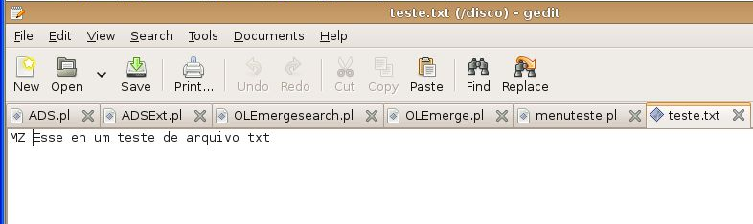
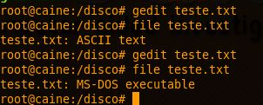

File Type Filtering (III)

Slide 21

File Filtering using Hash
File sorting/filtering using a hashset:
  To ignore known good files
  To alert presence of known bad files
Keeps the investigation focused on what really matters
Technique
Change a single byte in a string of an exe file
  Known good turns into an unknown file, increasing the amount of files to investigate
  Malware presence is not alerted
Ex: Perl script modifying the DOS Mode disclaimer in .EXE
Counter Technique

Slide 22
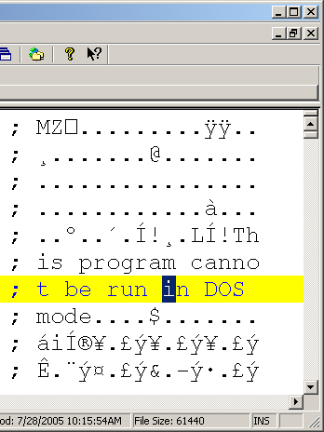
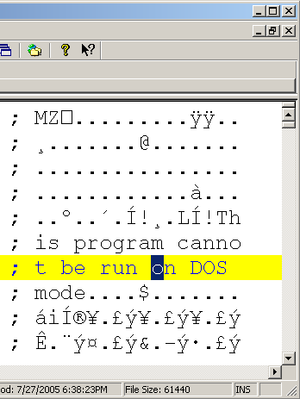
File Filtering using Hash (II)

Slide 23

Hash File Filtering: Counter-Counter-Technique
It’s the same to Live or Dead Analysis
Detection:
  Sort using fuzzy hash, if too many unknown files
    Always use fuzzy hash to check against malware
  Unknown .exe files never executed are suspect
    Check Prefetch files and Registry entries
  Hidden files must show up in order to be executed
    Check Recent shortcuts, Prefetch and Registry, looking for references to non-existing files

Slide 24
Hash File Filtering: Counter-Counter-Technique (II)
Pay attention to the timeline
  Files accessed near to unrelated .exe are suspicious
Some difficulties:
  Fuzzy hashset for ssdeep not available
    NSRL is still preparing their hashset
Tools:
  ssdeep, md5deep, sha1deep

Slide 25
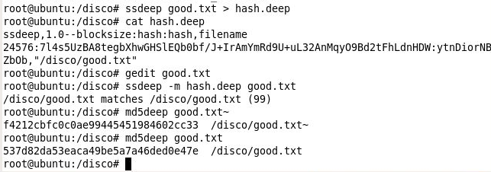
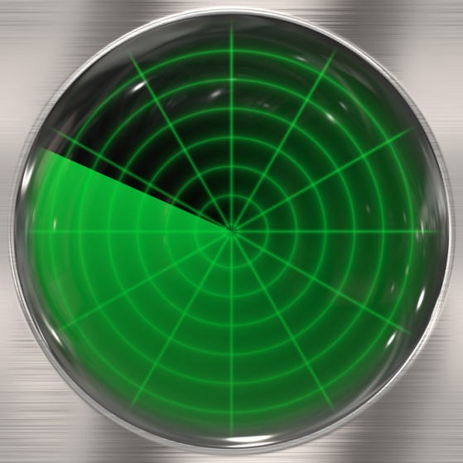
Hash File Filtering: Counter-Counter-Technique(III)
MD5 is completely different
fuzzy hash locates it

Slide 26

Content Analysis
File Content Analysis:
  Keyword Search
  Relevancy
Usually, after sorting/filtering out known good files
Techniques
Hide sensitive information:
  In non allocated blocks
  In fake bad blocks
  In slack spaces
Ex: Slacker
Counter-Technique

Slide 27
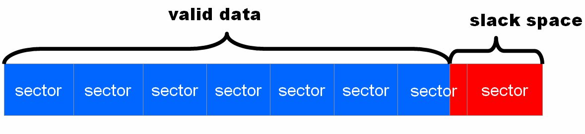
Slack space
1 cluster
Slacker writes here

Slide 28

Hiding Information: Counter-Counter-Technique
It’s the same to Live or Dead Analysis
Detection:
  Hidden files must be exposed before use
    Check Recent shortcuts, Prefetch and Registry entries for broken references
    Parts of temp files in non-allocated blocks (~xxxx.doc)
  Keyword search: Block based instead of file based
    TSK’s Blkls
      Problem: Will miss a keyword located in borders of non-contiguous blocks
  Malware hashset filtering/sorting
    Include slack space access tools (Bmap, Slacker) and Hex Editors

Slide 29
Slack space: Counter-Counter-Technique (II)
Chances to recover contents:
  Carving in Slack space/non allocated blocks
Obfuscated content ?
  There will be artifacts after file access
  Frequent user -> negligence -> artifacts will show up !
Tools
  TSK (Blk tools)
  Foremost, Scalpel, Photorec for carving
  Hashset filtering tools (md5deep, sorter)

Slide 30

Log Analysis
Analyze log contents
  Help determine who, where, when, what
  Events can be used in timeline
Technique
Destroy log data:
  Log wipe
  Critical log records deletion
  Fake log records insertion
Ex: Wipe
Counter-Technique

Slide 31
Log Analysis: Counter-Counter-Technique
It’s the same to Live and Dead Analysis
Detection:
  Correlation/timeline between logs
    Analyze Registry, Events, service logs
    Parts of temp files in non-allocated blocks
    External logs correlation: proxy, firewall, web servers
  If the information was locally wiped:
    Prefetch and Registry Artifacts
    Hashset filtering, alerting wipe tools
  Memory dump artifacts: erased events or wiping tools
Duplicated log server can trick intruders out !

Slide 32

Media artifacts search
Media analysis (HDs, thumb drives, etc)
  Dead or live analysis
  In a recent past, it was the only place where investigators used to look for artifacts
Technique
Avoid “touch” HD:
  Often used by attackers
  Code injected to the memory never touches HD
Ex: meterpreter, samjuicer
Counter-Technique

Slide 33
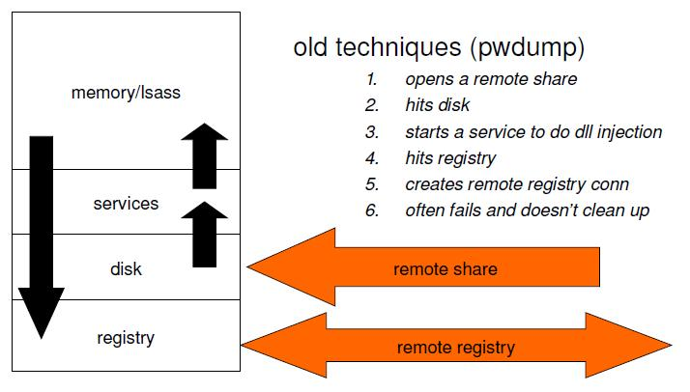
Meterpreter x pwdump

Slide 34
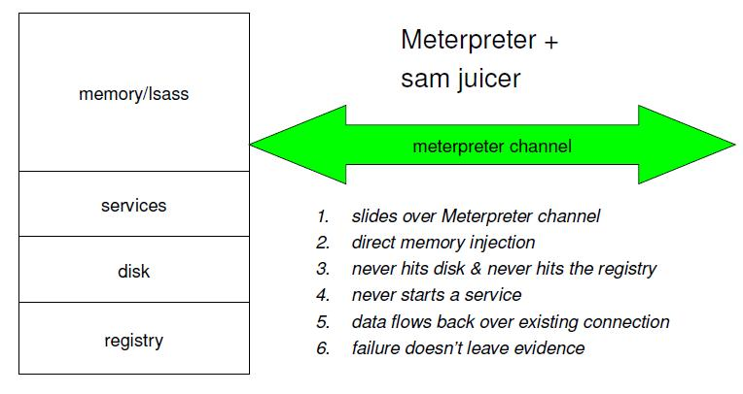
Meterpreter x pwdump (II)

Slide 35

Meterpreter: Counter-Counter-Techniques
Detection:
  Correlation/timeline between logs
    External logs correlation: proxy, firewall, web servers
  Memory acquisition is mandatory
    Artifacts are in memory dump
    Create a timeline with memory dump artifacts
    Mandiant tool to search for meterpreter artifacts in memory dumps

Slide 36
Meterpreter: Counter-Counter-Techniques (II)
Tools
  Mdd, win32dd, memoryze for RAM acquisition
  Volatility, Memoryze and MSFF (Mandiant Metasploit Forensic Framework) for analysis
  Perl scripts for bodyfile/timeline creation

Slide 37
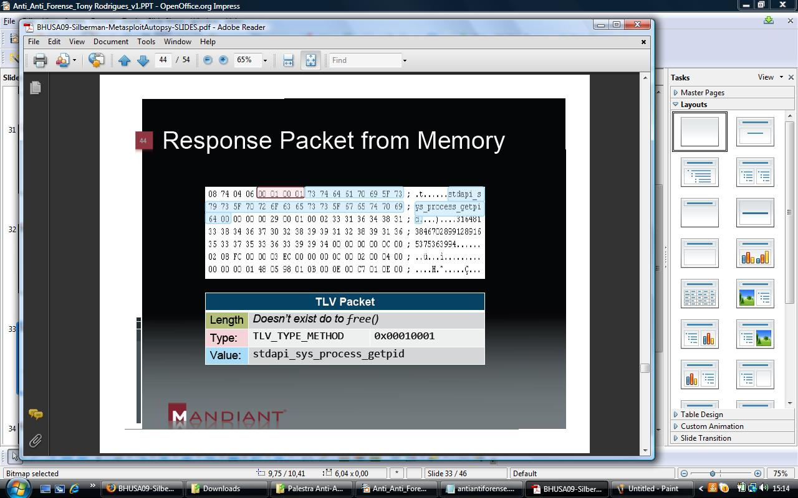
Meterpreter: Artifacts

Slide 38

Search for Volatile Data
Volatile data acquisition and analysis
  Using tools and commands
  Memory dump analysis
Technique
Rootkits:
  Attackers or users
  They can hide itself from commands and tools
They can hide itself from memory or disk acquisition
Counter-Technique

Slide 39
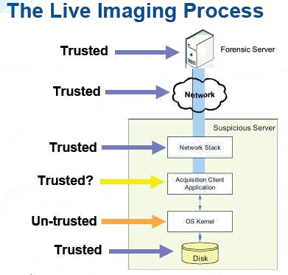
Forensics Image– Live Acquisition
Rootkits
Same for memory

Slide 40
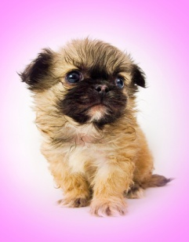
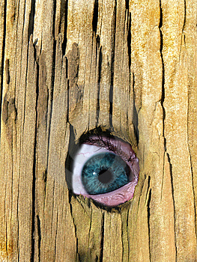


Practical Live-Operations Risk
Piece of cake, there’s just a tiny poodle. We can go, you first !
Yes !!
What are you seeing? Is it safe ?

Slide 41

Rootkits: Counter-Counter-Techniques
Detection:
  Dead Acquisition - Always
    Even more important if external machine behavior cannot be explained by what have been found:
      In memory dumps; or
      In disk image, acquired by Live acquisition
  Malware hashset filtering
  Correlation/timeline between logs
    External logs correlation: proxy, firewall, web servers

Slide 42
Rootkits: Counter-Counter-Techniques (II)
Combined techniques can hide the rootkit even from a dead analysis
  The investigator can boot the acquired image using a virtual machine, pause it and analyze the memory file, finding the rootkit
Tools:
  DD, DCFLDD, DC3DD for image acquisition
  Tools for memory acquisition and analysis
  Tools for rootkit search and a rootkit hashset
  VMWare Server or other virtualization + LiveView

Slide 43

Malware – Dynamic Analysis
Booting a virtual machine using the acquired image
  Malware behavior analysis
  Virtualization tools provide features to protect image integrity (aka snapshot)
Technique
Virtual machine blocking:
  Code detects virtual machine environment
  It cancels booting process
Ex: VMDetectLibrary.dll e AntiVM.exe
Counter-Technique

Slide 44

AntiVM: Counter-Counter-Technique
Detection:
  Registry entries and Prefetch
  Process leaves artifacts in the memory dump, hiberfil.sys and pagefile.sys
  Malware hashset filtering
    Include AntiVM tools in the hashset
  Tools:
    Memory acquisition and analysis
    Hashset filtering tools and a malware hashset
    WFA for Prefetch analysis
    RegRipper for Registry analysis

Slide 45
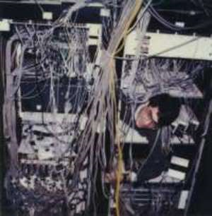
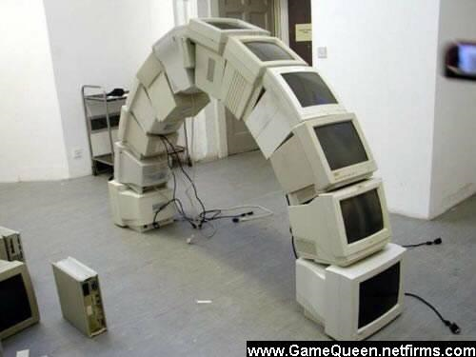
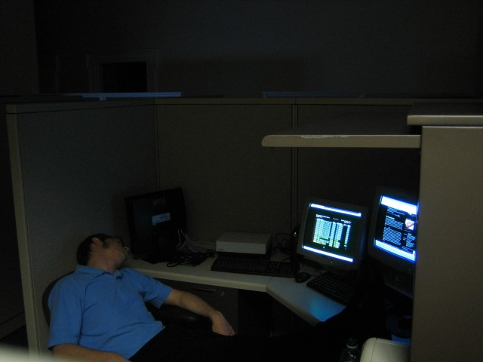
SysAdmin: Number One Anti Forensics Technique
- Logs ? Oh, we have no logs ! I’ve disabled them. We were wasting too much disk space ...

Slide 46

References
Anti-Forensics Website
  http:// www.anti-forensics.com
Low Down and Dirty – Anti Forensics Rootkits
  http:// www.blackhat.com/presentations/bh-jp-06/BH-JP-06-Bilby-up.pdf
Anti Forensics The Rootkit Connection
  http://www.blackhat.com/presentations/bh-usa-09/BLUNDEN/BHUSA09-Blunden-AntiForensics-SLIDES.pdf
Metasploit Autopsy – Reconstructing the Crime Scene
  http://www.blackhat.com/presentations/bh-usa-09/SILBERMAN/BHUSA09-Silberman-MetasploitAutopsy-SLIDES.pdf
Forensics FTW !
  http://www.continuumww.com/images/stories/cww/docs/ForensicsWinsDecember2008.pdf
Kernel Hacking and Anti Forensics – Evading Memory Analysis
  Hakin9 maio/2008

Slide 47
References II
Catch me if you can
  http://metasploit.com/data/antiforensics/BlueHat-Metasploit_AntiForensics.ppt
Defeating Forensic Analysis – The Metasploit Project
  http://metasploit.com/data/antiforensics/CEIC2006-Defeating_Forensic_Analysis.pdf

Slide 48
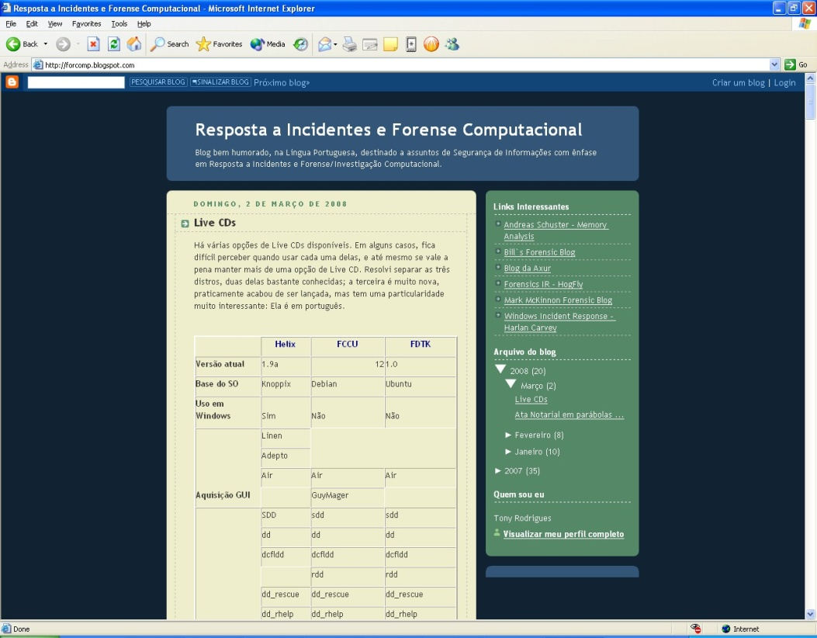
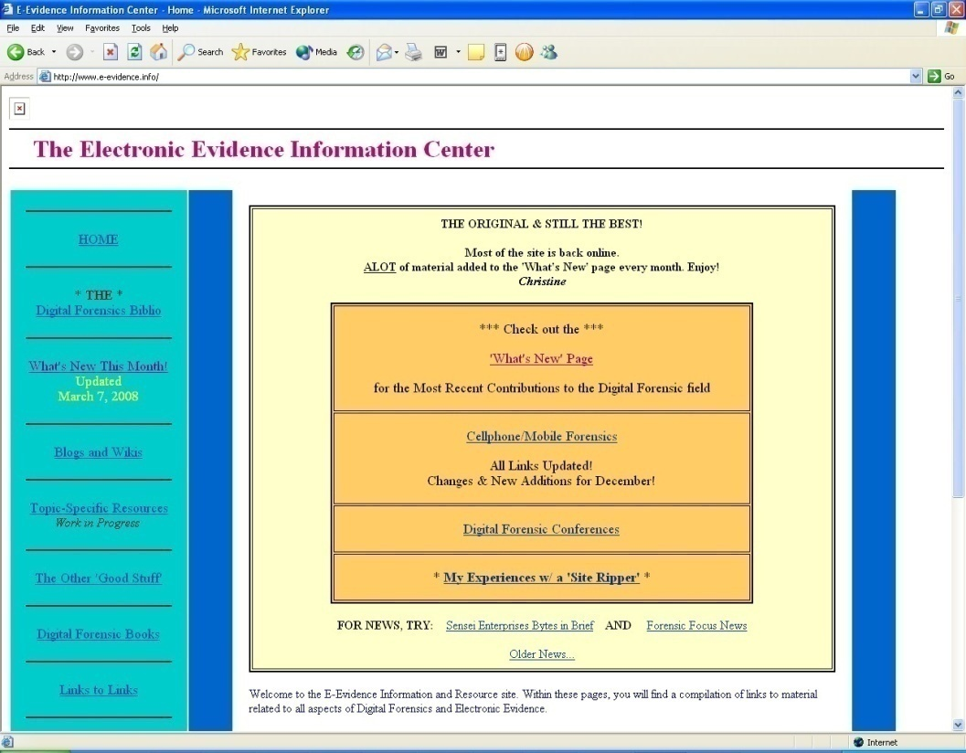
Further Readings
http://forcomp.blogspot.com
http://www.e-evidence.info
Notes:
Tão importante quanto os livros, acompanhar blogs e websites específicos de Forense Computacional é fundamental para se manter atualizado:
Resposta a Incidentes e Forense Computacional
Blog em Portugüês do autor desta apostila, Tony Rodrigues, CISSP. http://forcomp.blogspot.com
Além dos artigos, há vários links para outros blogs em inglês sobre o assunto.
E-Evidence Information Center (www.e-evidence.info)
Website que reúne informações em inglês sobre Forense Computacional, incluindo materiais e estudos publicados nas mais importantes conferências internacionais, como a Black Hat, a DFRWS e a HTCIA

Slide 49

Obrigado !
inv.forense (at) gmail (dot) com
(Tony Rodrigues)

